Slide 1

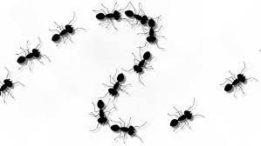
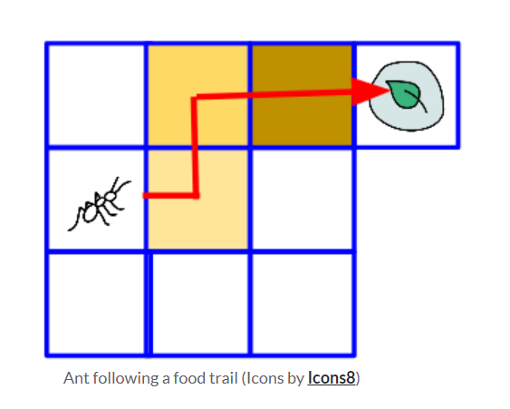
Ants Go Marching
By Padma Venkatraman

Slide 2
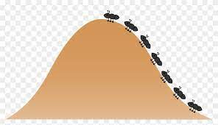
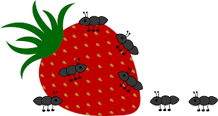
How ants scavenge for food, find food and update their nest
Ants initially wander randomly. After they find food, they lay pheromone trails as they return to their nest. This helps other ants crawling out of the nest find the food easily.
When other ants find such pheromone trails, they are likely to follow them rather than wander randomly.
Note: Chance is still involved!

Slide 3
I ran two models – one where the ant does not signal to other ants, and another one where it does.
When the ant “signaled” that it found food, it was more likely that other ants converged upon the food, whereas when the ant did not.
The yellow trail in the upcoming slides, is the pheromone trail.
It converges to a question of: does an ant on a pheromone trail, know its on the trail?
And thus we go from random walk → random walk with specified probability.

Slide 4
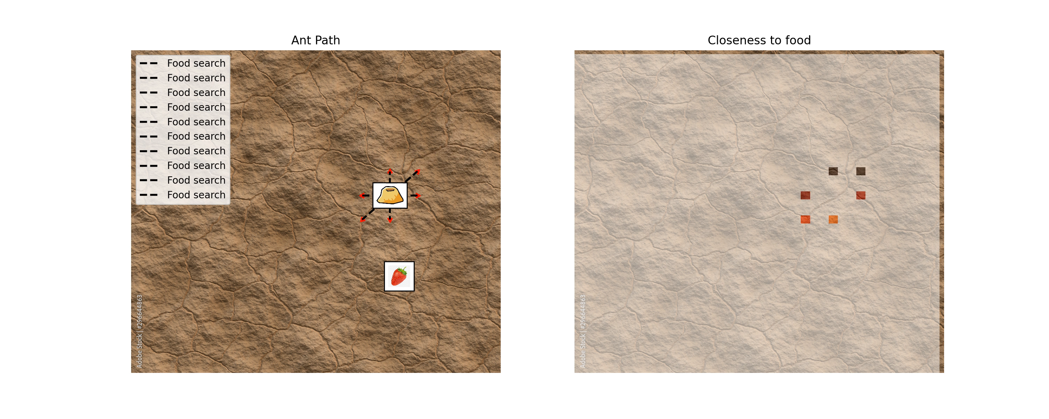
Time at which first ant found food: 1:90 No of ants found food = 2
No signaling:

Slide 5
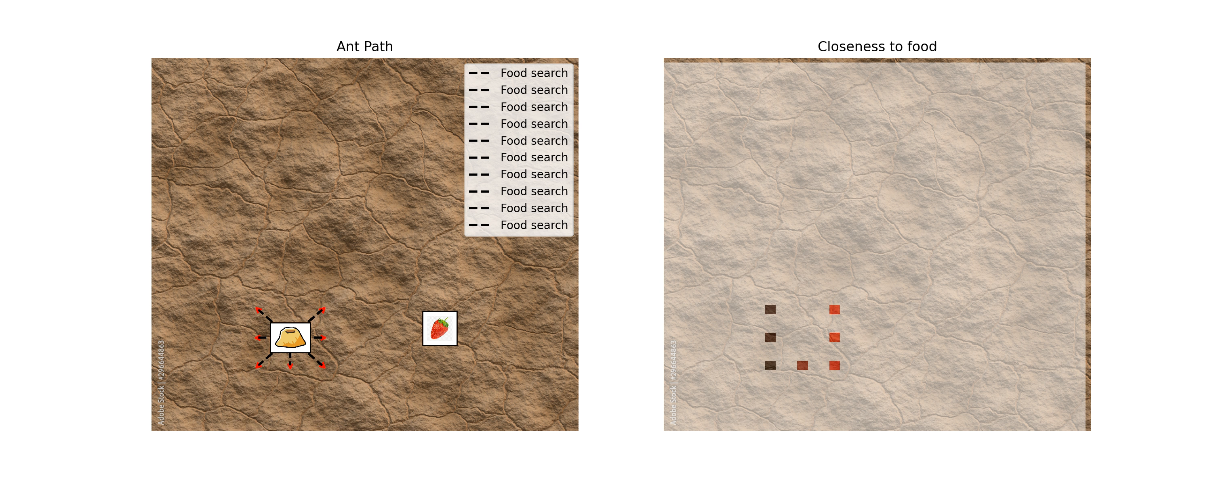
Time at which first ant found food: 4:20 No of ants found food = 4
Signaling:

Slide 6
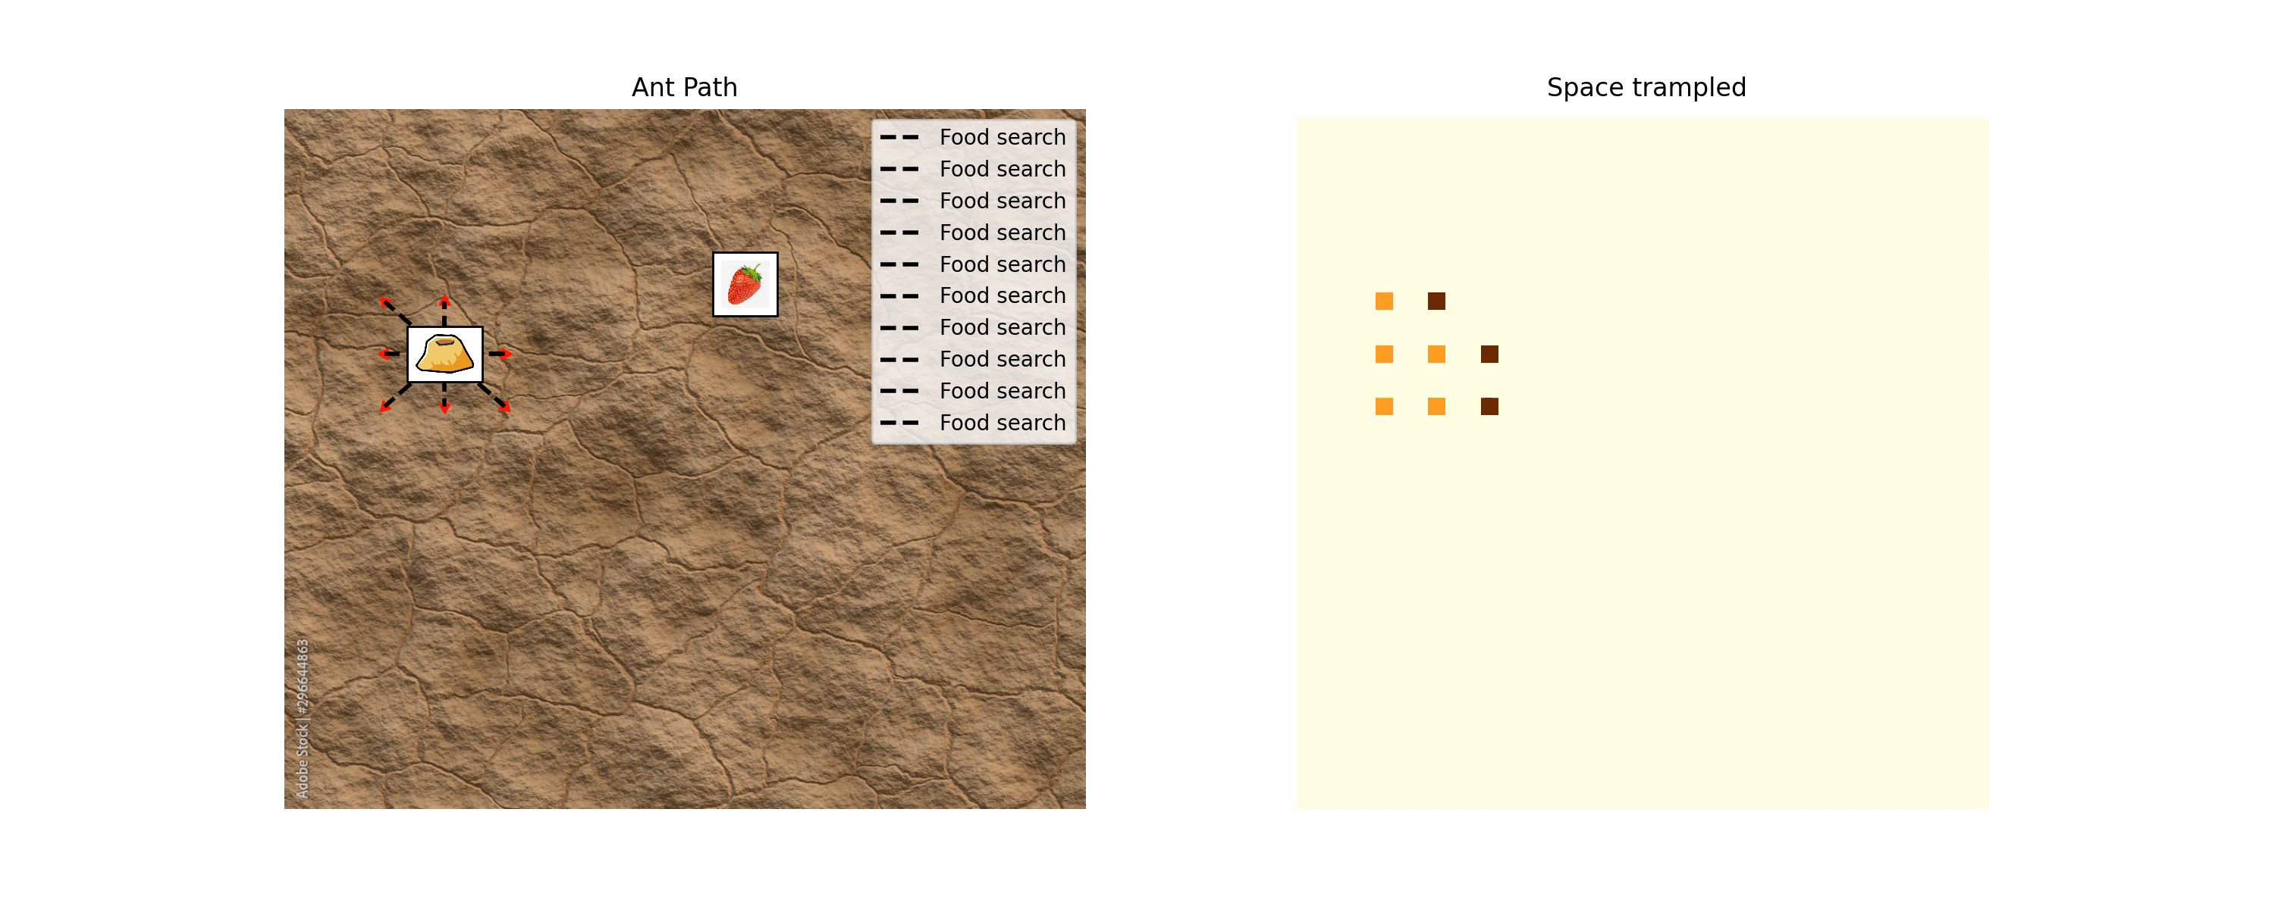

Slide 7
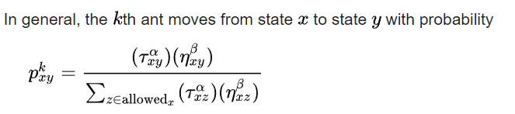
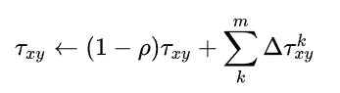
Sources and formulas:
https://onestepcode.com/ant-colony-simulation/

Slide 8
